Slide 1

Ressources humaines : diapositive 1
Deep Reinforcement Learning & Dynamic Scheduling

Slide 2
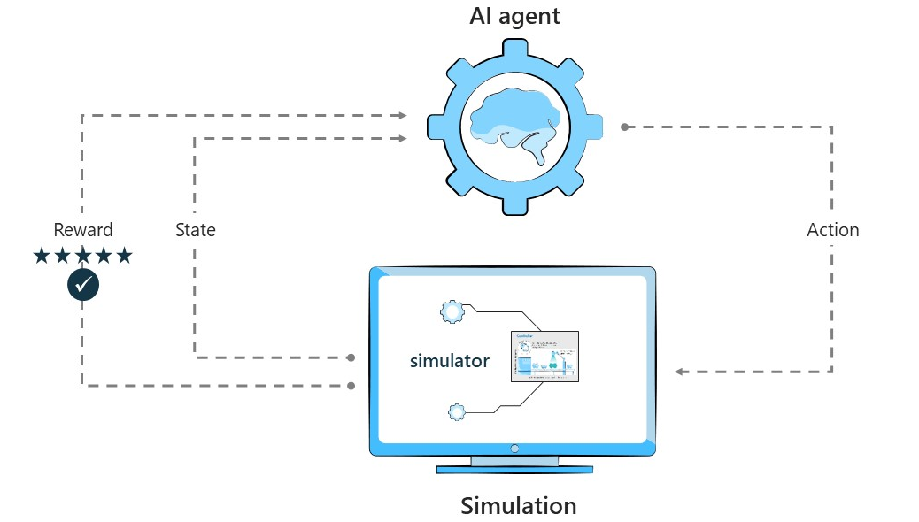
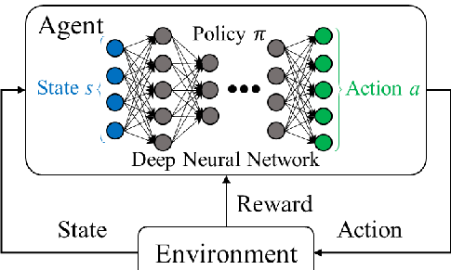
Ressources humaines : diapositive 5
2
DEEP REINFORCEMENT LEARNING (DRL)
DRL is a subfield of machine learning. It is about to learn from a sequence of actions. Each RL agent creates a representation of states based on the data which it gathers from the environment. More specifically, RL is about learning how to map states to actions in order to maximize the reward value.
Through a series of trial and error, a machine keeps learning, making this technology ideal for dynamic environments that keep changing.

Slide 3
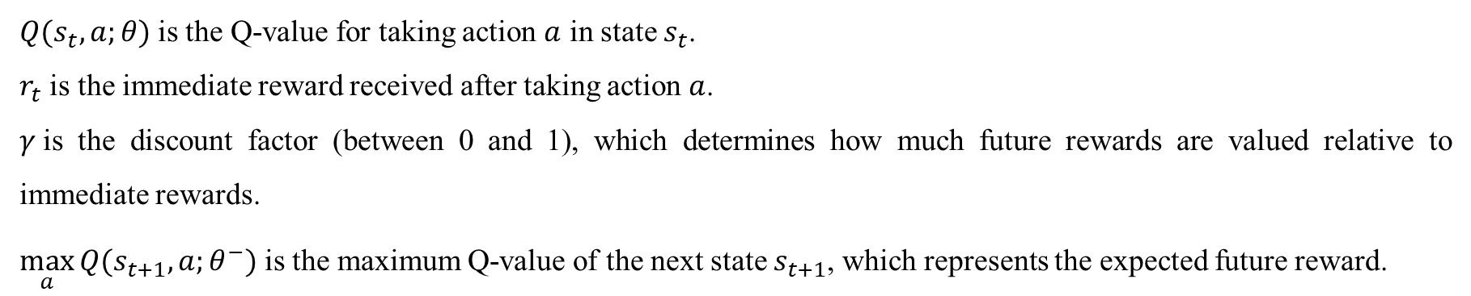
Ressources humaines : diapositive 5
6
DYNAMIC SCHEDULING FOR FLEXIBLE JOB SHOP BY DEEP REINFORCEMENT LEARNING
In Q-learning, the Bellman equation is used to express the Q-value for a given state-action pair as the sum of two parts:
The immediate reward from taking the action.
The discounted future reward, which is the maximum expected Q-value of the next state.
The Bellman equation for Q-values is:
$$Q(s_{t},a;θ)=r_{t}+γ.\max_{a}{Q(s_{t+1},a;θ^{−})}$$
$Q(s_{t},a;θ)$is the Q-value for taking action $a$ in state $s_{t}$.
$r_{t}$ is the immediate reward received after taking action $a$.
$γ$is the discount factor (between 0 and 1), which determines how much future rewards are valued relative to immediate rewards.
$\max_{a}{Q(s_{t+1},a;θ^{−})}$is the maximum Q-value of the next state $s_{t+1}$, which represents the expected future reward.

Slide 4
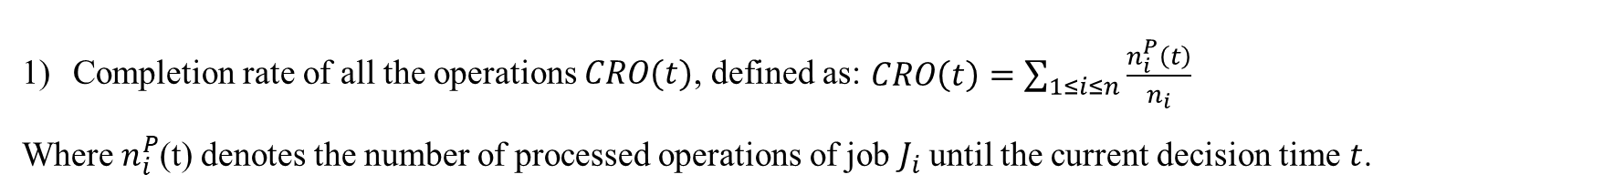
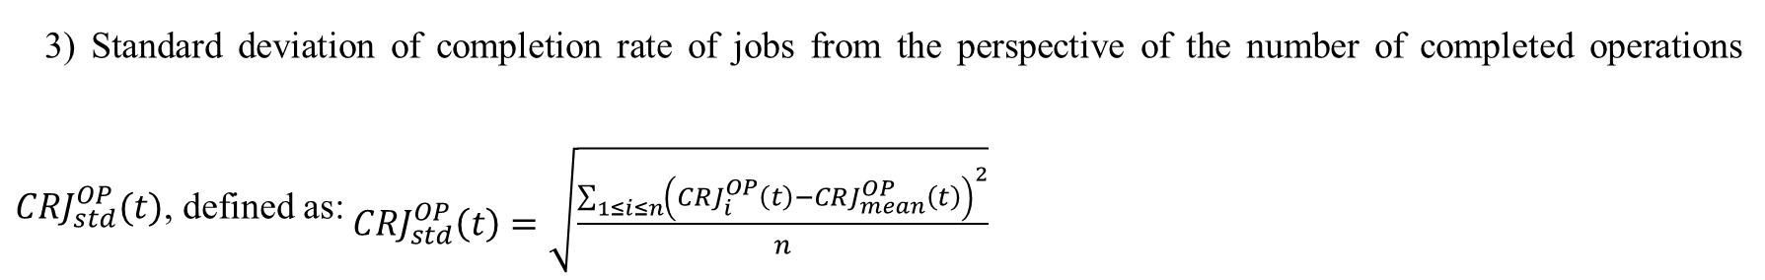
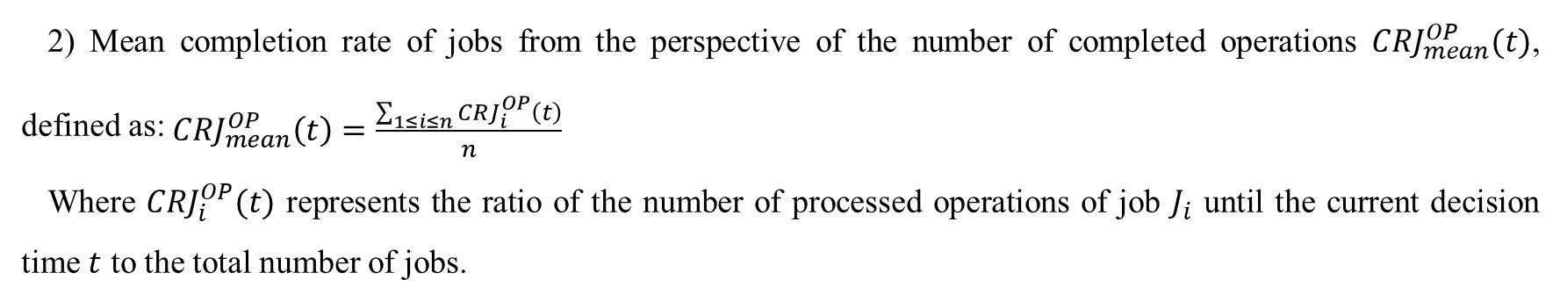
Ressources humaines : diapositive 5
7
STATE FEATURES – Reducing Tardiness Rate
Completion rate of all the operations $CRO(t)$, defined as: $\begin{aligned}CRO\left(t\right)=\sum_{1≤i≤n}{\frac{n_{i}^{P}\left(t\right)}{n_{i}}}\#\end{aligned}$
Where $n_{i}^{P}$(t) denotes the number of processed operations of job $J_{i}$ until the current decision time $t$.
2) Mean completion rate of jobs from the perspective of the number of completed operations ${CRJ}_{mean}^{OP}(t)$, defined as: $\begin{aligned}{CRJ}_{mean}^{OP}\left(t\right)=\frac{\sum_{1≤i≤n}{{CRJ}_{i}^{OP}\left(t\right)}}{n}\#\end{aligned}$
Where ${CRJ}_{i}^{OP}(t)$ represents the ratio of the number of processed operations of job $J_{i}$ until the current decision time $t$ to the total number of jobs.
3) Standard deviation of completion rate of jobs from the perspective of the number of completed operations ${CRJ}_{std}^{OP}(t)$, defined as: $\begin{aligned}{CRJ}_{std}^{OP}\left(t\right)=\sqrt{\frac{\sum_{1≤i≤n}{{\left({CRJ}_{i}^{OP}\left(t\right)−{CRJ}_{mean}^{OP}\left(t\right)\right)}^{2}}}{n}}\#\end{aligned}$

Slide 5
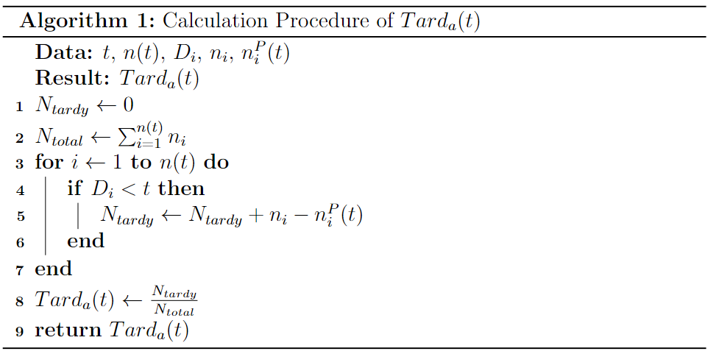
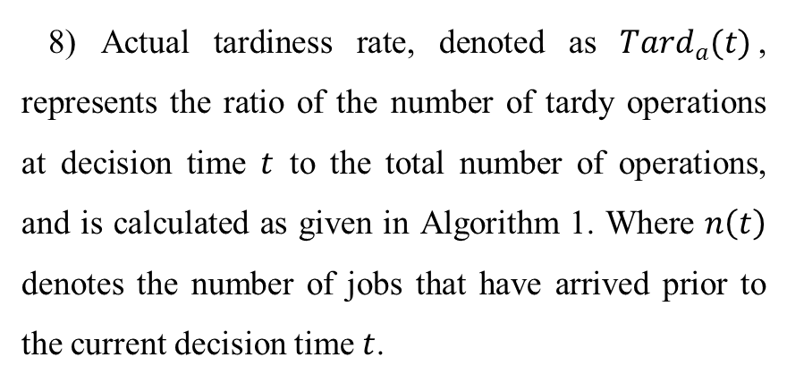
Ressources humaines : diapositive 5
7
STATE FEATURES – Reducing Tardiness Rate
4) Expected value (λ) of the interarrival time (subject to exponential distribution exp(1/λ)) between two successive new job arrivals.
5) due date tightness (DDT).
6) Total number of jobs.
7) Proportion of idle machines to the total number of machines.
8) Actual tardiness rate, denoted as ${Tard}_{a}(t)$, represents the ratio of the number of tardy operations at decision time $t$ to the total number of operations, and is calculated as given in Algorithm 1. Where $n\left(t\right)$ denotes the number of jobs that have arrived prior to the current decision time $t$.

Slide 6
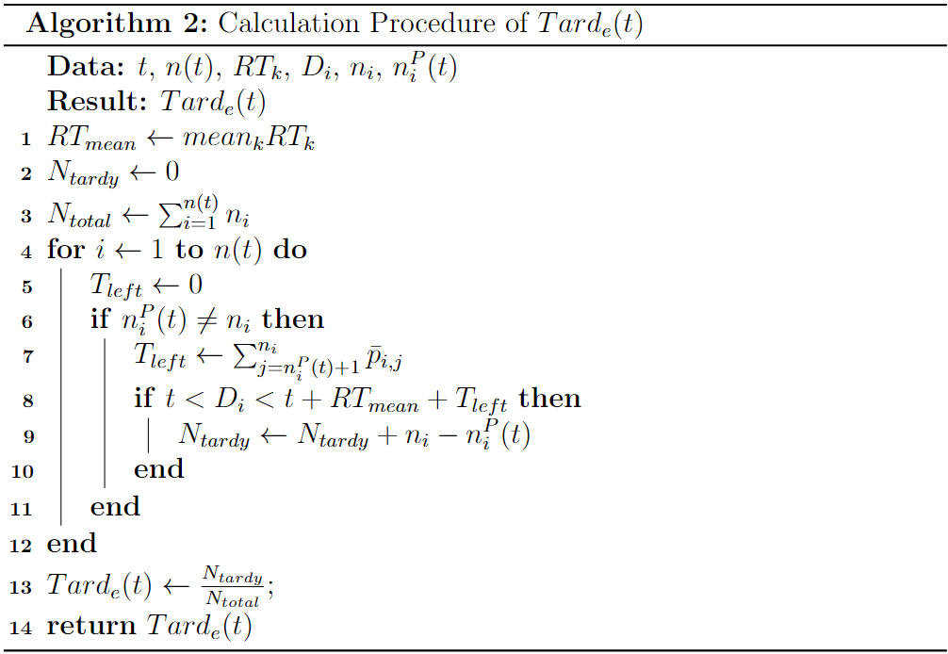
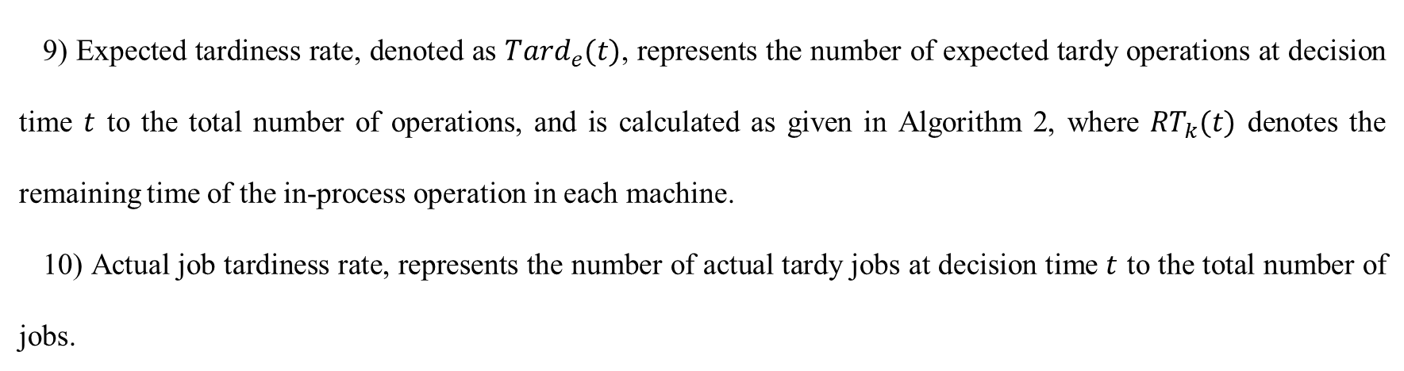
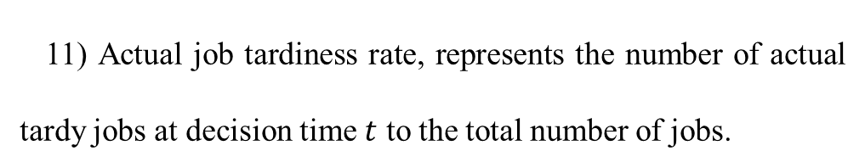
Ressources humaines : diapositive 5
7
STATE FEATURES – Reducing Tardiness Rate
9) Expected tardiness rate, denoted as ${Tard}_{e}(t)$, represents the number of expected tardy operations at decision time $t$ to the total number of operations, and is calculated as given in Algorithm 2, where ${RT}_{k}(t)$ denotes the remaining time of the in-process operation in each machine.
10) Actual job tardiness rate, represents the number of actual tardy jobs at decision time $t$ to the total number of jobs.
11) Actual job tardiness rate, represents the number of actual tardy jobs at decision time $t$ to the total number of jobs.

Slide 7
Ressources humaines : diapositive 5
7
ACTIONS
1) Most Remaining Processing Time (MRT) Heuristic
Action: Select the operation of the job with the most remaining processing time on the current machine.
Use Case: Prioritizes longer tasks to reduce the likelihood of bottlenecks in the schedule.
2) Least Remaining Processing Time (LRT) Heuristic
Action: Select the operation of the job with the least remaining processing time on the current machine.
Use Case: Focuses on quickly finishing shorter tasks, which can free up resources faster.
3) Shortest Processing Time (SPT) Heuristic
Action: Select the operation with the shortest processing time on the current machine.
Use Case: Focuses on short tasks, reducing job queue lengths.

Slide 8
Ressources humaines : diapositive 5
7
ACTIONS
4) Earliest Due Date (EDD) Heuristic
Action: Select the operation of the job with the earliest due date on the current machine.
Use Case: Minimizes lateness by prioritizing tasks with the nearest deadlines.
5) Minimal Critical Ratio (MCR) Heuristic
Action: Select the operation with the minimal critical ratio (MCR) for the entire job.
Use Case: Balances processing time and due dates, focusing on tasks at risk of becoming critical.
6) Slack Time (SLK) Heuristic
Action: Select the operation with the smallest slack time for the current machine.
Use Case: Prevents tasks from becoming overdue by focusing on those with tight deadlines.

Slide 9
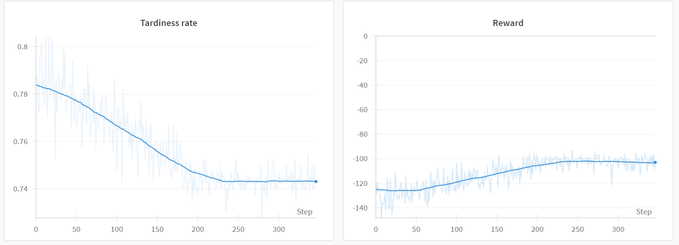
Ressources humaines : diapositive 5
7
THE OBTAINED REWARD CURVE

